Slide 1
My Dream Job
L.K.Chaithvika
Notes:
we are walking centers of data production. Mckinsey estimates by the the end of this year we will create 50 times the amount of data that we did in 2011. There’s too much data. And not enough insights from this data. A data scientist basically uses math and programming skills to create applications that can analyze large amounts of data to extract social and economic value. This part really intrigued me to become a data scientist in future. So there’s my dream job “Data Scientist”

Slide 2

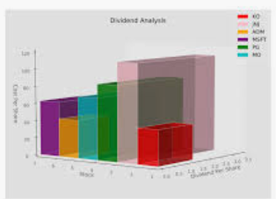

DATA SCIENTIST
Moral responsibility
Interested in Statistics
Build new models
Huge requirement in market
Make good money
Notes:
I always wanted to do something useful to the society with the knowledge I have. And this role helps me doing that. We can analyze different kinds of data and predict the future of various situations. The more we can understand data the more we can infer from it and help people.
I am one person who I like been productive, innovative and results oriented. Data science been an interdisciplinary field about processes and systems to extract knowledge or insights from data in various forms, either structured or unstructured, which is a continuation of some of the data analysis fields such as statistics, machine learning, data mining, and predictive analytics, similar to Knowledge Discovery in Databases(KDD) encompasses all of my character traits listed above thus why I see data scientist career path its the perfect job match for me. And involving allot of technology to always produce good results.
What really motivate me to be a data analyst, is the potential I usually see in the big data which is currently available in the internet. From my own point of view in this data, lays brilliant business opportunity if well analysed and this will be the solution to the big problem of poverty and unemployment which is a big challenge to our nation.
In addition to job creation, another motivating factor is my love for technology and doing research. Data science career which is very experimental and involving allot of creativity job, is the perfect career path which undoubtedly match with my hobbies.

Slide 3


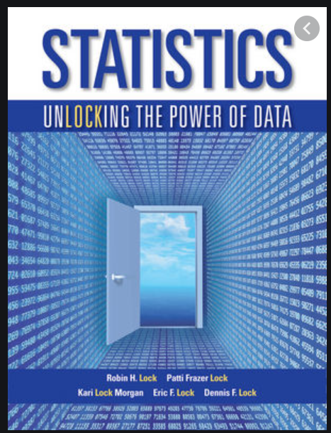


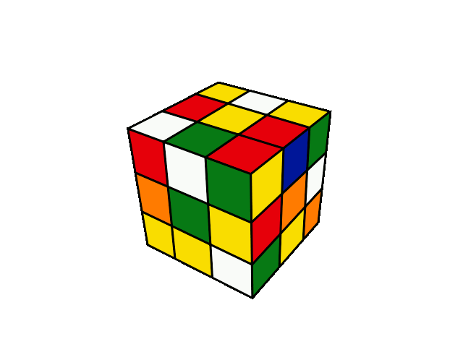
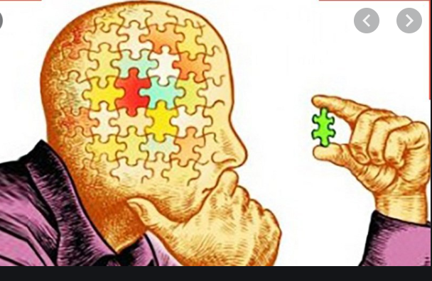
TECHNICAL SKILLS
SOFT SKILLS
Programming
Collaboration
Statistics
Communication
Analytical Thinking
Problem solving
Notes:
Data science, although a highly paid and very rewarding role, is also probably one of the most challenging. Particularly against the current backdrop of AI hype in business. In order to navigate the particular challenges you may face as a data scientist you will need to foster excellent communication skills, resilience and grit, creativity and business acumen to succeed.
Critical thinking
Effective communication
Proactive problem solving
Intellectual curiosity
Business sense
Ability to prepare data for effective analysis
Ability to leverage self-service analytics platforms
Ability to write efficient and maintainable code
Ability to apply math and statistics appropriately
Ability to leverage machine learning and artificial intelligence (AI)

Slide 4






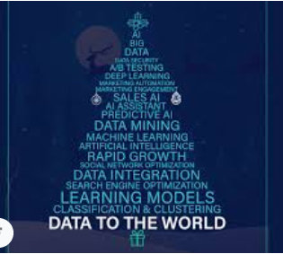
Coding Competitions
Practice Building Models
STRATEGY
Analyze Data
Knowledge Sharing
Notes:
Done Certified Online Courses In Data Science, Machine Learning, R, Python , Hadoop , Tableau, Sas from Udemy.

Slide 5
THANK YOU

